Slide 1
PROJECT TITLE
CAPSTONE PROJECT
Presented By: Sravanthi Y
Student Name : Sravanthi Y
College Name & Department : Dr DY Patil Vidyapeeth, MBA in AI and ML

Slide 2
Problem Statement
Design and implement a method for hiding a secret text message within a digital image using steganography techniques, specifically employing the Least Significant Bit (LSB) method. The system should be able to reliably encode the message into the image and decode it back to the original text.

Slide 3
OUTLINE
Problem Statement:- Design and implement a method for hiding a secret text message within a digital image using steganography techniques, specifically employing the Least Significant Bit (LSB) method. The system should be able to reliably encode the message into the image and decode it back to the original text.
Technology used:- Python
Wow factor :- hides secret messages inside images, making them invisible to the eye. It uses a simple yet powerful technique, the Least Significant Bit method, along with a length prefix to ensure robustness.
End users:-Security and Intelligence Agencies
Result:-Successful Encoding and Decoding
Conclusion:- project developed a steganography system that cleverly hides text messages within images using the LSB technique..
Future scope:- Higher Capacity: Hide more data per image. Increased Robustness: Resist image changes.
Git-hub Link:- https://github.com/Sravanthi171/Stegnograph--Project

Slide 4
Technology used
Language:-Python,
Libraries:-Pillow (PIL - Python Imaging Library):
Role: Image manipulation (opening, reading, modifying pixels, saving).
io:
Role: Handling byte data (specifically, working with uploaded file data).
IPython.display
Role: Allows for displaying images in a Jupyter notebook.
google.colab.files
Role: Allows for uploading files to, and downloading files from a Jupyter notebook.

Slide 5
Wow factors
Hidden in Plain Sight: Secret messages are invisible within normal-looking images.
Simple yet Powerful: Basic LSB manipulation achieves effective data hiding.
Length prefix: The system is robust due to the length prefix.
Covert Communication: Demonstrates potential for hidden data transfer.
Technical Elegance: Clever bit manipulation and decoding algorithms.
Learned skills: This program shows skills in both image and computer bit manipulation.
Adaptable: The program works with any input image.
WOW algorithm: This program is in the same field as the cutting-edge WOW algorithm.

Slide 6
End users
Security and Intelligence Agencies
Law Enforcement
Cybersecurity Professionals
Digital Rights Management
Journalists and Activists

Slide 7
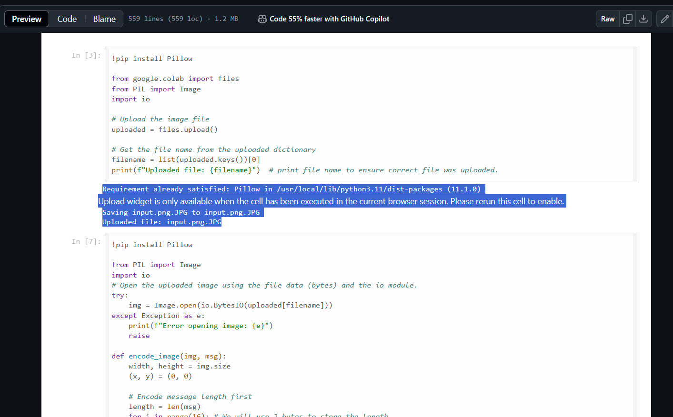
Results

Slide 8
Results

Slide 9
Conclusion
This project successfully demonstrates image steganography by effectively concealing and retrieving text messages within images using the LSB method. The addition of a length prefix ensures robust decoding. This system provides a strong example of how simple techniques can achieve covert communication.

Slide 10
GitHub Link
https://github.com/Sravanthi171/Stegnograph--Project/tree/main

Slide 11
THANK YOU

